Slide 1
Topic 4: Part I
Searching and Sorting
【See Chap.12 in the textbook】

Slide 2
Objectives
To be able to implement and use the linear search and binary search algorithms to find data in an array.
To appreciate the differences in efficiency between these algorithms.
To understand the implementation of a simple sorting algorithm called selection sort.
To recognize how the efficiency of the selection sort algorithm depends on the number of data items.

Slide 3
Two important array operations
Searching, which is the process of finding a particular element in an array.
Sorting, which is the process of rearranging the elements in an array so that they are stored in some well-defined order.

Slide 4
12-1 Searching
Example:
Function FindFirstVowel that appears as part of the piglatin.c program (Figure 10-5) searches a string to find the first vowel.
The implementation :
int FindFirstVowel (stirng word)
{
int i;
for (i = 0; i< StringLength (word); i++) {
if (IsVowel (IthChar (word, i))) return (i);
}
return (-1);
}

Slide 5
Searching in an integer array
Function FindIntegerInArray looks for the integer key in an array.
int FindIntegerInArray (int key, int array[], int n)
{
int i;
for (i = 0; i < n; i++) {
if (key ==array[i]) return (i);
}
return (-1);
}

Slide 6
FIGURE 12-1 findcoin.c
/*
* File: findcoin.c
* -------------------
* This program uses a search operation to report the names of
* legal U.S. coins.
*/
#include <stdio.h>
#include <ctype.h>
#include “simpio.h”
#include “genlib.h”

Slide 7
/*
* Global variables
* -----------------------
* coinNames - - Array containing the name of each coin
* coinValues - - Array containing the corresponding coin values
* nCoins - - Number of distinct coins
*/
static stirng coinNames[ ] = {
“penny”,
“nickel”,
“dime”,
“quarter”,
“half-dollar”,
};
static int coinVlaues[ ] = { 1, 5, 10, 25, 50};
static int nCoins = sizeof coinValues / sizeof coinValues[0];
static int FindIntegerInArray (int key, int array[ ], int n) ;

Slide 8
/* Main program */
main()
{
int value, index;
printf (“This program looks up names of U.S. coins.\n”);
printf (“Enter coin value: “);
value = GetInteger();
index = FindIntegerInArray (value, coinVlaues, nCoins);
if (index == -1) {
printf (“There is no such coin.\n”);
} else {
printf (“That’s called a %s.\n”, coinNames[index]);
}
}

Slide 9
/*
* Function: FindIntegerInArray
* Usage: index = FindIntegerInArray (key, array, n);
* ------------------------------------------------------------------
* This function returns the index of the first element in the
* specified array of integers that matches the value key. If
* key does not appear in the first n elements of the array,
* FindIntegerInArray returns –1.
*/
static int FindIntegerInArray (int key, int array[], int n)
{
int i;
for (i = 0; i < n; i++) {
if (key == array[i]) return (i);
}
return (-1);
}

Slide 10
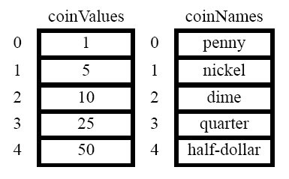
Parallel Array:
Using corresponding index positions to store related data values.

Slide 11
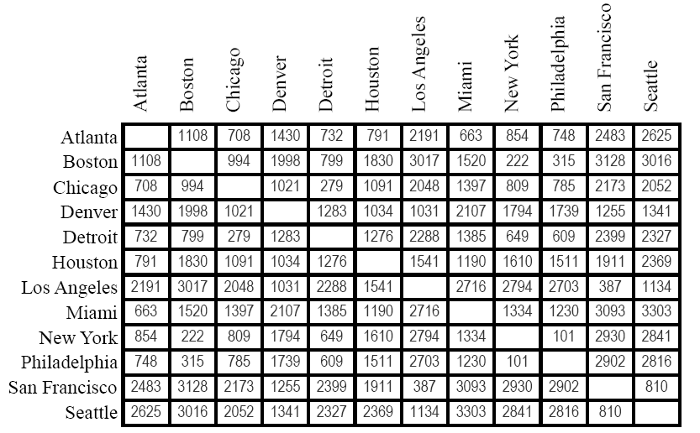
Sophisticated example of searching
Mileage Table

Slide 12
#define NCities 12
static int mileageTable[NCities][NCities] = {
{ 0,1108, 708,1430, 732, 791,2191, 663, 854, 748,2483,2625},
{1108, 0, 994,1998, 799,1830,3017,1520, 222, 315,3128,3016},
{ 708, 994, 0,1021, 279,1091,2048,1397, 809, 785,2173,2052},
{1430,1998,1021, 0,1283,1034,1031,2107,1794,1739,1255,1341},
{ 732, 799, 279,1283, 0,1276,2288,1385, 649, 609,2399,2327},
{ 791,1830,1091,1034,1276, 0,1541,1190,1610,1511,1911,2369},
{2191,3017,2048,1031,2288,1541, 0,2716,2794,2703, 387,1134},
{ 663,1520,1397,2107,1385,1190,2716, 0,1334,1230,3093,3303},
{ 854, 222, 809,1794, 649,1610,2794,1334, 0, 101,2930,2841},
{ 748, 315, 785,1739, 609,1511,2703,1230, 101, 0,2902,2816},
{2483,3128,2173,1255,2399,1911, 387,3093,2930,2902, 0, 810},
{2625,3016,2052,1341,2327,2369,1134,3303,2841,2816, 810, 0},
};

Slide 13
static string cityTable[NCities] = {
"Atlanta",
"Boston",
"Chicago",
"Denver",
"Detroit",
"Houston",
"Los Angeles",
"Miami",
"New York",
"Philadelphia",
"San Francisco",
"Seattle",
};

Slide 14
All your program has to do is execute the following steps:
1. Read in the names of the two cities as strings.
2. Find the index positions at which the city
names occur in the cityTable array.
3. Use the index positions to select the result
from mileageTable.

Slide 15
Assuming that you can implement a function FindStringInArray, the rest of the program is straightforward:
main()
{
int city1, city2;
printf (“This program looks up intercity mileage.\n”);
city1 = GetCity (“Enter name of city #1: “);
city2 = GetCity (“Enter name of city #2: “);
printf (“Distance btween %s”, cityTable[city1]);
printf “ and %s:” cityTable[city2]);
printf” %d miles.\n”, mileageTable[city1][city2];
}

Slide 16
static int GetCity (string prompt)
{
stirng cityName;
int index;
while (TURE) {
printf (“%s”, prompt);
cityName = GetLine ();
index = FindStringInArray (cityName, cityTable, Ncities);
if (index >= 0)break;
printf (“unknown city name - - try again.\n.”);
}
return (index);
}

Slide 17
Linear Search
The only piece missing from the program is the code for FindStringInArray.
The algorithm used in FindStirngInArray is called the linear search algorithm.
The search starts at the beginning of the array and goes straight down the line of elements until it finds a match or reaches the end of the array.

Slide 18
FIGURE 12-2 FindStringInArray
/*
* Function: FindStringInArray
* Usage: index = FindStringInArray (key, array, n);
* ----------------------------------------------------------------
* This function returns the index of the first element in the
* specified array of string that matches the value key. If
* key does not appear in the first n elements of the array,
* FindStringInArray returns –1.
*/
static int FindstringInArray (string key, string array[], int n)
{
int i;
for (i = 0; i < n; i++) {
if (StringEqual (key, array[i])) return (i);
}
return (-1)
}

Slide 19
Binary Search
How to take advantage of the fact that the cityTable array is already in alphabetic order?
To illustrate the process as concretely as possible, let’s suppose that you are looking for San Francisco in an array with the following values:

Slide 20
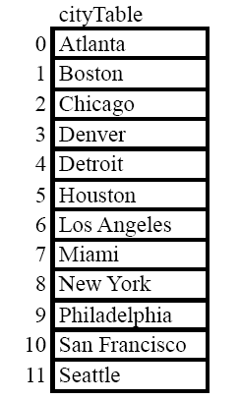

Slide 21

Instead of starting at the top of the array as in linear search, we start by picking an element somewhere near the center.
The index of the center element can be computed by averaging the endpoints of the index range and is therefore:

Slide 22
When evaluated using integer arithmetic, this expression has the value 5.
The city name stored in cityArray[5] is Houston.
San Francisco must come after Houston because the array is in alphabetic order.

Slide 23
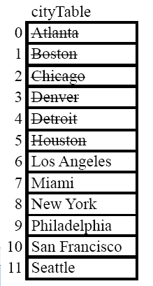
We can immediately eliminate all the city names in index positions 0 through 5:

Slide 24
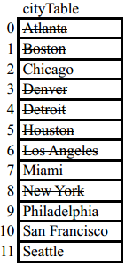

Next, San Francisco must lie between positions 6 and 11 of cityTable.
The center of that range can therefore be computed by evaluating:


Slide 25
This algorithm—looking at the center element in a sorted array and then determining which half to search—is called binary search.
Function FindStringInSortedArray, which uses the binary search algorithm, appears in Figure 12-3.

Slide 26
FIGURE 12-3 FindStringInSortedArray
/*
* Function: FindStringInSortedArray
* Usage: index = FindStringInSortedArray(key, array, n);
* -------------------------------------------------------------------------
* This function returns the index of an element that matches key
* in the specified array of strings, which must be sorted in
* lexicographic order. If key appears more than once in the
* array, the function can return any index at which it appears.
* If key does not appear at all in the first n elements
* of the array, FindStirngInSortedArray returns –1.
*
* This implementation uses the binary search” algorithm. At each
* stage, the function computes the midpoint of the remaining
* key . If there is a match, the function returns the index.
* If the key is less than the string at the at index position, the
* function sea4ches in the first half of the array; if the key is
* larger, the function searches in the second half of the array.
*/

Slide 27
int FindStringInSortedArray(string key, string array[], int n)
{
int lh, rh, mid, cmp;
lh= 0;
rh = n –1;
while (lh <= rh) {
mid= (lh + rh) / 2;
cmp = StringCompare(key, array[mid]);
if (cmp == 0) return (mid);
if (cmp < 0) {
rh = mid – 1;
} else {
lh = mid + 1;
}
}
return (-1);
}

Slide 28
Efficiency of the search algorithms
To search an array of N elements requires N comparisons if you use linear search and log₂N comparisons if you use binary search.
The formulas do not convert a real sense of how these algorithms compare.

Slide 29
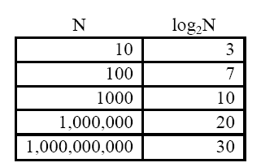
The following table shows the closest integer to log₂N for various values of N.

Slide 30
If we have an array with 1,000,000,000 elements, linear search requires 1,000, 000,000 comparisons to search that array in the worst case.
Whereas the binary search algorithm gets the job done using at most 30 comparisons.

Slide 31
12-2 Sorting
The binary search algorithm requires that the array elements be listed in sorted order.
Sorting an integer array
Interface: sort.h

Slide 32
FIGURE 12-4 sort.h
/*
* File: sort.h
* --------------
* This file provides an interface to a simple procedure
* for sorting an integer array into increasing order.
*/
#infndef _sort_H
#define _sort_H
/*
* Function: SortIntegerArray
* Usage: SortIntegerArray (array, n);
* ----------------------------------------------
*/
void SortIntegerArray (int array[], int n);
#endif

Slide 33

The selection sort algorithm
Of the many possible sorting algorithms, one of the easiest to explain is the selection sort algorithm.
To get a sense of the selection sort approach, watch what happens if you start with the following array of numbers:

Slide 34
The pseudocode as follows:
for (each index position lh in the array) {
Let rh be the index of the smallest value
between lh and the end of the list
Swap the elements at index positions
lh and rh
}

Slide 35
The coding of the SortIntegerArray :
void SortIntegerArray (int array[], int n)
{
int lh, rh;
for (lh = 0; lh < n; lh++) {
rh = FindSmallestInsteger (array, lh, n-1);
SwapIntegerElements (array, lh, rh);
}
}
int FindSmallestInteger (int array[], int low, int high)
{
int i, spos=low;
for (i = low; i <= high; i++) {
if (array[i] < array[spos]) spos = i;
}
return (spos);
}

Slide 36
Evaluating the efficiency of selection sort
The selection sort algorithm has several positive qualities.
For one, it is relatively easy to understand.
For another, it gets the job done.
The most efficient ones require techniques beyond your current level of programming knowledge.
The more efficient sorting algorithms will discuss in chapter 17.

Slide 37
How long it takes to execute selection sort on a given set of input data?
You can run the program and measure how long it takes.
2. You can think more generally about the operation of the program and try to develop a qualitative sense of how it behaves.

Slide 38
Using the following code to compute the time require to perform a calculation:
double start, finish, elapsed;
start = (double) clock () / CLOCKS_PER_SEC;
… Perform some calculation…
finish = (double) clock () /CLOCKS_PER_SEC;
elapsed = finish – start

Slide 39
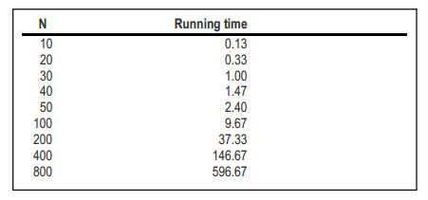

Some experiments:

Slide 40

Analyzing the selecting sort algorithm
The fact that selection sort is a quadratic algorithm is not surprising if you think about how it works.
Given N elements, the time required to execute the selection sort algorithm is proportional to the following sum:

Slide 41
The quadratic behavior comes from the appearance of the N² term.
The process of applying mathematical techniques to predict algorithmic efficiency is called analysis of algorithms, which is discussed further in Chapter 17.

Slide 42
SUMMARY
The linear search algorithm operates by looking at each element of an array in sequential order until the desired element is found.
The binary search algorithm is much more efficient than linear search but requires that the elements of the array be in sorted order.
Sorting algorithms vary considerably in their efficiency. For arrays containing a small number of elements, simple algorithms such as selection sort are perfectly adequate.

Slide 43
Homeworks（2题）
1、教材第12章练习2、练习8，2题选做1题。
2、教材第12章练习11、练习12，2题选做1题。

